Slide 1


CODEBASICS RESUME PROJECT CHALLANGE #6
Power BI Desktop

Slide 2

Challenge : Provide Insights to the Marketing Team in Food & Beverage Industry
Power BI Desktop
Domain: F & B Function: Marketing
CodeX is a German beverage company that is aiming to make its mark in the Indian market. A few months ago, they launched their energy drink in 10 cities of India.
Their Marketing team is responsible for increasing brand awareness, market share, and product development. They conducted a survey in those 10 cities and received results from 10k respondents. Peter Pandey, a marketing data analyst is tasked to convert these survey results to meaningful insights which the team can use to drive actions.

Slide 3


Power BI Desktop

Slide 4

Demographic Insights
Power BI Desktop
Who prefers Energy Drinks
Energy Drink Preference by Age Group Marketing Reaching Youth(15-30)
5.5K
6K
Print media 6.36%
Outdoor billboards
10.02%
Female 34.55%
Non-binary 5.07%
5K
4K
Other 10.02%
3K
Online ads 48.13%
2.4K
2K
1.5K
Male 60.38%
1K
TV commercials
25.47%
0.4K
0.2K
0K
19-30 31-45 15-18 46-65 65+
Insights:- 1. More than 60% of Males prefer Energy Drinks compared to 35% females.
Mostly People of age group 19-30 prefers Energy Drinks.
Online ads and TV commercials reaches around 74% of people of age 15-30.

Slide 5

Consumer Preferences
Power BI Desktop
Preferred Ingredients
Packaging Preferences
4K
3.9K
Compact and portable cans
3984
3K
3047
Innovative bottle design
2.5K
1501
2K
2.0K
Collectible packaging
1.6K
983
Eco-friendly design
1K
485
Other
0K
Caffeine Vitamins Sugar Guarana
Insights :- 1. People Prefer Caffeine as the main ingredient in Energy Drinks.
2 compact and portable cans followed by Innovative bottle designs are preferred by the consumers.

Slide 6

Competition Analysis
Power BI Desktop
Market Share by Different Brands
Reasons for Choosing Energy Drink Brand
Cola-Coka 3K | Gangster 2K | Sky 9 1K
 | Blue Bull 1K
Bepsi 2K
 |  | Others 0K
 | CodeX 1K
3K
2.7K
2K
2.0K
1.9K
1.7K
1.7K
1K
0K
Brand reputation
Taste/flavor preference
Availability Effectiveness
Other
Insights :- Cola-Coka and Bepsi are the 2 current Market leaders ,covering 25% and 21% of market closely followed by Gangster with 18%. Codex currently has 9% of the total market.
2 27% People choose their Energy Drink on the basis of Brand Reputation and 20% choose on the basis of Taste.

Slide 7

Marketing Channels and Brand Awareness
Power BI Desktop
Marketing Channels With their respective reach Perception about Limited Edition Packaging
Energy Drink Preference by Age Group
5.5K
6K
4.0K
4.0K
4K
No
2.7K
4K
3.9K
Yes
2.4K
2K
1.2K
1.2K
2K
2.0K
1.5K
Not Sure
0.8K
0.4K
0K
0.2K
19-30 31-45 15-18 46-65 65+
Online ads TV commerc…
Outdoor billboards
Other
Print media
0K
0K
5K
Insights:- 1 Online ads and Tv commercials are the 2 best Marketing channels to reach out to our customers.
2 Peoples reaction on Limited edition Packaging is not so positive so we should not focus much on this. 3 people of age between 15 to 45 covers 94% of the market so we must focus on this Age group and
online ads and Tv advertisements reaches this group more so must act accordingly.

Slide 8


Brand Penetration
Power BI Desktop
Average Rating
3.28
Brand Perception
Negative 17.69%
Positive 22.57%
Neutral 59.74%
Performance in Different Cities
3K
2.8K
2K
1.8K
1.5K
1K
0.9K
0.9K
0.6K
0.5K
0.4K
0.4K
0.2K
0K
Bangalore
Hyderabad
Mumbai
Chennai
Pune
Kolkata
Ahmedabad
Delhi
Jaipur
Lucknow
Insights:- Codex current Avg. Rating is 3.28 which is not bad but we must look to improve on it by providing our customers with the best energy drink experience.
Codex Brand perception is pretty much Neutral at present which is a positive we must work on it to build postive perception .
Lucknow,Jaipur, Delhi , Ahmedabad and Kolkata are the cities we need to focus on .

Slide 9

Purchase Behaviour
Power BI Desktop
Purchase Locations Consumption Situation
Supermarkets
4.5K
4K
4.5K
Online retailers
2.6K
3.2K
Gyms and fitness ce…
1.5K
2K
Local stores
1.5K
0.8K
0K
0.5K
0.3K
Other
0.7K
Other
Sports/exer…
Studying/w…
Social outin…
Driving/co…
0K
2K
4K
Preferred Price Range
Insights:- 71% of people buy energy drinks from Supermarkets and online retailers.
45% of people consume energy drinks during and
sports or exercise and 32/% consume before studying or working late , that tells most of consumers are young .
84% of consumers want price range to be not more than 150. 53% want price range less than 100.
4K
4.3K
3.1K
2K
1.6K
1.0K
0K
50-99
100-150
Above 150
Below 50

Slide 10

Product Development
Power BI Desktop
Reasons for choosing Energy drinks
Other 16.79%
Effectiveness 17.48%
Brand reputation 26.52%
Availability 19.1%
Taste/flavor preference 20.11%
Insights:- 26% of people choose their energy drink on the basis of Brand Reputation and 20% choose on the basis of Taste/Flavor Preference 19% on the basis of Availability of the product.
so, we need to work on building our brand reputation and we need to introduce few more flavors . we also need to make our product available at all the supermarkets and on online stores.

Slide 11

Recommendations for Codex
Power BI Desktop
1 Immediate Improvements to the products :-
Should reduce Sugar Content and focus on adding more natural ingredients
Should introduce more flavors.
Can change packaging to Compact and Portable cans.
We can also use some innovative bottle designs.
Can introduce more products with Caffeine in it .
Count of Improvements_desired by Improvements_desired
Reduced sugar content
2995
More natural ingredients
2498
Wider range of flavors
2037
Healthier alternatives
1472
Other
998
0
500
1,000
1,500
2,000
2,500
3,000

Slide 12

Recommendations For Codex
Power BI Desktop
Ideal Price for the Product:-
84% respondends want prices of energy drinks to be under Rs 150 and 53% of total respondents want prices to be under Rs 100.
So, Rs 100 should be the price for the product.
Preferred Price Range
4K
4.3K
3.1K
2K
1.6K
1.0K
0K
50-99
100-150
Above 150
Below 50

Slide 13
Recommendations for Codex
Power BI Desktop
Marketing campaigns :-
"Be Relentless" this could be our slogan and we can run a Marketing campaign around this slogan/tagline.
This Sleek and simple tagline will also make it easy to promote our product on Social media , this will make our product Instragrammable.
Charitable cause promotions
Why not kill two birds with one stone? Make an impact in your community while attracting more customers with a charitable sales promotion. Let your customers know that for a certain period of time, a portion of your proceeds will go to a charity you support.

Slide 14
Recommendations For Codex
Power BI Desktop
Offers and Discounts
Referral discounts
One way to keep the new customers rolling in is to offer discounts when current customers refer a friend or promote you on social media.
Cashbacks
Many consumers would agree that it doesn’t feel as bad to spend money when you get some in return. It’s almost like paying less from the start and then having extra money to get other desirable products.
Plus giving back to customers usually results in more loyalty and more business from them.
Target audience
60% of males prefer Energy Drinks and people of age between 15-45 consumes 94% of the total Drinks.
People Mostly consume Energy drinks during any Sports Activity and during Studying or Working Late
night, which are the traits of Younger people.

Slide 15
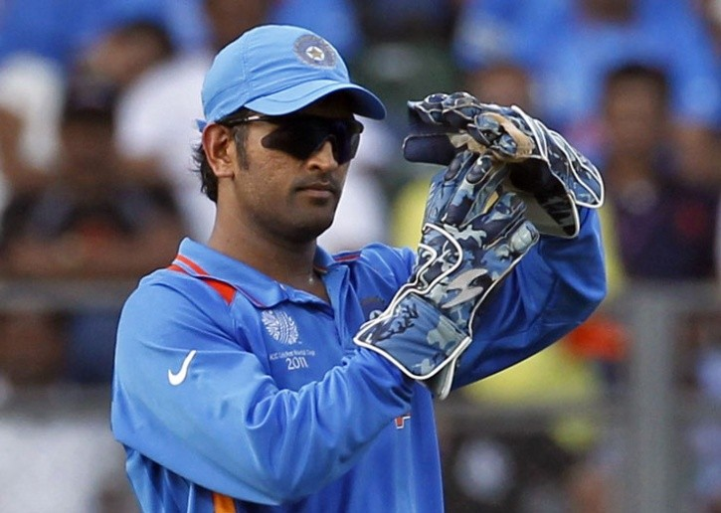
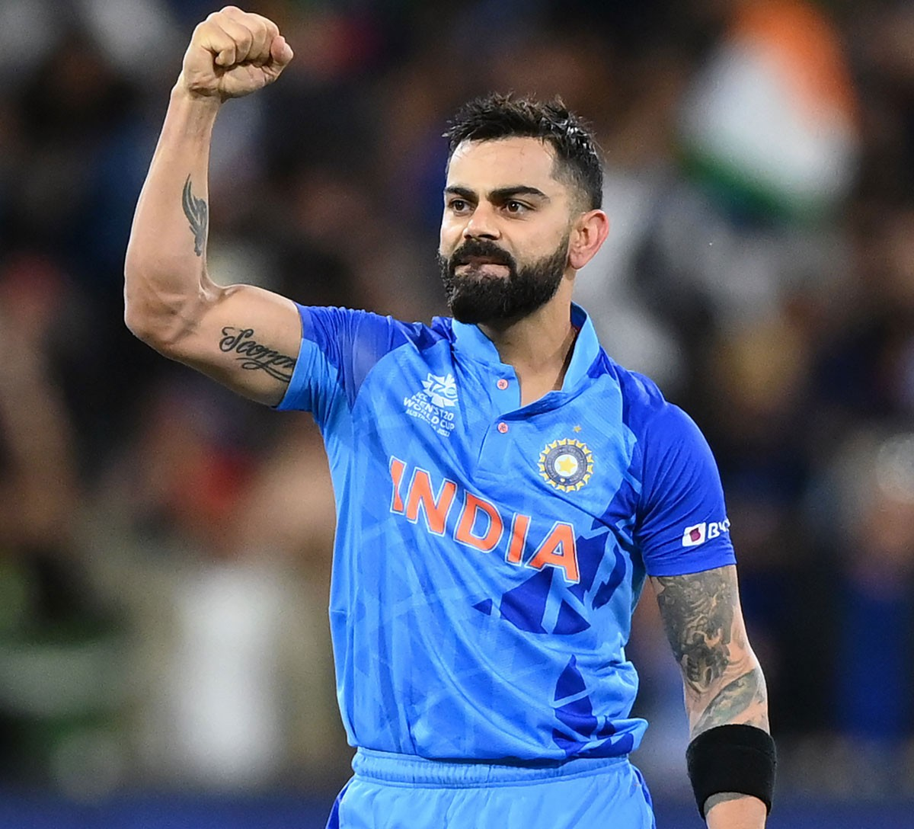
Recommendations for Codex
Power BI Desktop
Brand Ambassador Recommendations :-
since at present Codex is trying to build its Brand reputation . So, we need a reliable person whom people trust .
At present Cricket is the biggest thing so Codex Brand Ambassador has to be a Cricketer.
Their is no one better than MS Dhoni at present. Another option is Virat Kohli.

